Slide 1
Widget Architecture 2.0 development
Widget Extensions

Slide 2
Agenda
Understanding Extensions
Extending Widget Functionality

Slide 3
Understanding Extensions
Extensions Overview
Notes:
Before developing a widget, trainees need to understand what a widget is. For people that haven’t worked with BB portal before, there might be confusion with things like jquery widgets etc.

Slide 4
What is an extension?
“An extension allows developers to customize a widget’s logic and presentation. The combination of the widget-core and its extension defines the widget”
Notes:
Key points:
Mini-applications: they contain logic and perform operations, which is different from a ui widget like those defined in jquery ui, or in bootstrap
Autonomous: they should work, by themselves in any page that you use them, without depending on other widgets to function properly. This doesn’t mean that they need to contain all the libraries used. They can depend on js libraries that exist in the global project scope
Reusable: A widget is meant to be used multiple times, in different portals, in the same portal, and some times even in the same page. We need to keep this in mind while developing
Business Logic: Widgets should contain business logic and minimal styling.

Slide 5
Understanding Extensions
UI Component
UI Component
Extension
UI Component
Widget
UI Component
UI Component
Extension
Notes:
Every widget requires an extension, but you can switch extensions

Slide 6
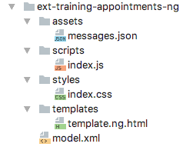
Extension Anatomy
Extension scaffolding
Presentation
Styles
Behavior
Definition
Assets

Slide 7
Demo: Switch Extensions
Let’s look at how flexible widgets are by switching their extension.
Notes:
KEY
Show how easy it is to switch extension and explain the possibilities.
HOW
Go to the Retail Banking Demo portal and go to the Places page
The widget will probably not work, so you need to get an API key from google (if you are logged in as Backbase user, it might fail. Try using personal google account):
https://developers.google.com/maps/documentation/javascript/get-api-key
Now the widget will show the map and if you are in Amsterdam, it shows an ATM there.
Switch the extension to: ext-bb-places-list-map-ng and show the behavior of zooming out to view other ATM, it will be listed on the left
Switch the extension to: ext-bb-places-list-ng and notice that data is still the same, just different view and functionality
TIME
8 mins

Slide 8
Exercise
Exercise
Create a tile view for the Contact Manager Widget by generating a custom extension.
Use the UI Component “ui-bb-avatar” for the tile view
Customize Widget Styles
Notes:
This is the point where you must switch to the repository:
Repository URL: https://bitbucket.org/backbase/training-cxp-fe
In order to have access to the training repository use the following credentials:
User: training@backbase.com
Password: b4ckb4s3-tr41n1ng

Slide 9
Extending Widget Functionality
Understanding Extensions
Notes:
Before developing a widget, trainees need to understand what a widget is. For people that haven’t worked with BB portal before, there might be confusion with things like jquery widgets etc.

Slide 10
Hooks
Extending Widget Functionality
Notes:
Before developing a widget, trainees need to understand what a widget is. For people that haven’t worked with BB portal before, there might be confusion with things like jquery widgets etc.

Slide 11
What are Hooks?
“Hooks are defined places within a widget-core from which a developer's code can be called. This allows data being passed to an endpoint and data received from an endpoint to be changed in someway.”
Notes:
Key points:
Mini-applications: they contain logic and perform operations, which is different from a ui widget like those defined in jquery ui, or in bootstrap
Autonomous: they should work, by themselves in any page that you use them, without depending on other widgets to function properly. This doesn’t mean that they need to contain all the libraries used. They can depend on js libraries that exist in the global project scope
Reusable: A widget is meant to be used multiple times, in different portals, in the same portal, and some times even in the same page. We need to keep this in mind while developing
Business Logic: Widgets should contain business logic and minimal styling.

Slide 12
Hooks
Implementing a hook
Hooks provides the ability to transform received data or data to be sent
Developers can not add new data fields within a hook’s implementation
A hook will be called only if it is implemented
Every hook provides a specific set of data to the implementation.
The available hooks list can be found in the Widget’s Documentation
Notes:
Presentation template: It uses the Widget Controller.
Styles: Try to avoid the use of variables or mixins. You’re going to get duplicated code.
Behavior: You can refer to this url for further explanations: https://my.backbase.com/docs/product-documentation/documentation//Retail-Banking/2.3.0/extending-a-collection-widget.html

Slide 13
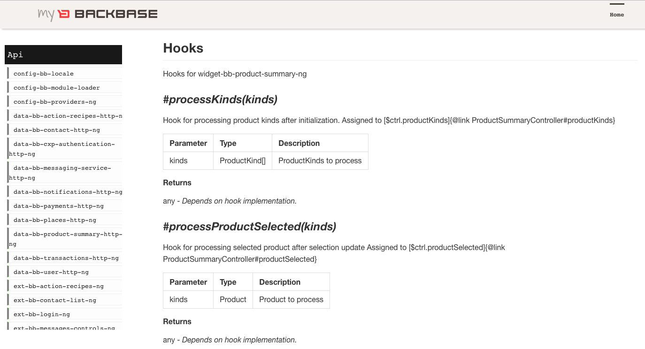
Implementing Hooks
Product Summary Widget hooks
Notes:
http://docs.backbase.com/extranet/technical-docs/collection-retail/2.3.0/widget-bb-product-summary-ng.html

Slide 14
Implementing Hooks
Product Summary Widget hooks
#processKinds(kinds)
Purpose:
Intended to allow the Developer to process the different kind of account types.
Return:
Any. It depends on the implementation
Example:
The implementation will return reversed product kinds names
const NAME_PREFIX_PREFERENCE = 'namePrefix'; export const hooks = (context) => { const NAME_PREFIX = context.widget.getStringPreference(NAME_PREFIX_PREFERENCE); return { processKinds: (productKinds) => productKinds.map(kind => Object.assign({}, kind, { name: `${NAME_PREFIX}${kind.name}` }) ) }; });
export const hooks = { processKinds: (productKinds) => productKinds.map(kind => Object.assign({}, kind, { name: kind.name.split('').reverse().join('') }) ) };
Note: This approach will not let the developer to access the widget’s preferences
Notes:
Presentation template: It uses the Widget Controller.
Styles: Try to avoid the use of variables or mixins. You’re going to get duplicated code.
Behavior: You can refer to this url for further explanations: https://my.backbase.com/docs/product-documentation/documentation//Retail-Banking/2.3.0/extending-a-collection-widget.html

Slide 15
Exercise
Exercise
Implement a hook within the Contact Manager Widget extension that will show a different avatar image.
Find the Hook that will allow you to change the avatar image
Get the avatar image externally
Notes:
This is the point where you must switch to the repository:
Repository URL: https://bitbucket.org/backbase/training-cxp-fe
In order to have access to the training repository use the following credentials:
User: training@backbase.com
Password: b4ckb4s3-tr41n1ng

Slide 16
Extension Specific Preferences
“A widget is black-boxed and developers cannot add new preferences to the widget. In order to implement Extension-Specific Preferences, we need to create them manually in CXP Explorer and document it”
Notes:
Key points:
Mini-applications: they contain logic and perform operations, which is different from a ui widget like those defined in jquery ui, or in bootstrap
Autonomous: they should work, by themselves in any page that you use them, without depending on other widgets to function properly. This doesn’t mean that they need to contain all the libraries used. They can depend on js libraries that exist in the global project scope
Reusable: A widget is meant to be used multiple times, in different portals, in the same portal, and some times even in the same page. We need to keep this in mind while developing
Business Logic: Widgets should contain business logic and minimal styling.

Slide 17
Extension Specific Preferences
For documentation purposes
// model.xml
<catalog> <feature> <name>ext-training-contact-tiles-ng</name> <contextItemName>[BBHOST]</contextItemName> <properties> <property label="Version" name="version" viewHint="text-input,admin,designModeOnly"> <value type="string">0.1.0-alpha.0</value> </property> <property name="randomUserApiEndpoint" label="Random Lego Avatar" viewHint="admin,designModeOnly"> <value type="string">
https://randomuser.me/api/portraits/lego
</value> </property> </properties> </feature> </catalog>
Notes:
Presentation template: It uses the Widget Controller.
Styles: Try to avoid the use of variables or mixins. You’re going to get duplicated code.
Behavior: You can refer to this url for further explanations: https://my.backbase.com/docs/product-documentation/documentation//Retail-Banking/2.3.0/extending-a-collection-widget.html

Slide 18
Extension Custom Preferences
viewHint attribute
<property label="Version" name="version" viewHint="designModeOnly,admin,text-input"> <value type="string">0.1.0-alpha.0</value> </property>
String composed of the following optional, comma-separated parts
[designmode]: Where the property can only be edited within CXP Manager
[role]: The role needed to edit the property via the preference form
[input-field]: What input field is displayed in the preference form
1 | [designmode],[role],[input-field]
Notes:
viewHint attribute
EXPOSES PREFERENCES – ALLOWS FOR PERSONALIZATION
- We are not going to talk about the fact there is 4th part (order) because it’s not working. (https://backbase.atlassian.net/browse/MAINT-4424)
The order of the attributes may vary without altering the final result
The mentioned reference is this one: https://my.backbase.com/docs/product-documentation/documentation//portal/5.6.3/xsd_portalservices_propertytype.html

Slide 19
Exercise
Exercise
Refactor the Hook to use an Extension-Specific Preference
Use the Widget Object in the Hook
Create the property via CXP Explorer
Notes:
This is the point where you must switch to the repository:
Repository URL: https://bitbucket.org/backbase/training-cxp-fe
In order to have access to the training repository use the following credentials:
User: training@backbase.com
Password: b4ckb4s3-tr41n1ng

Slide 20
Events
Extending Widget Functionality
Notes:
Before developing a widget, trainees need to understand what a widget is. For people that haven’t worked with BB portal before, there might be confusion with things like jquery widgets etc.

Slide 21
Events
“The Publish and Subscribe pattern, often referred to simply as PubSub is used to pass information between widgets.”
Notes:
Key points:
Mini-applications: they contain logic and perform operations, which is different from a ui widget like those defined in jquery ui, or in bootstrap
Autonomous: they should work, by themselves in any page that you use them, without depending on other widgets to function properly. This doesn’t mean that they need to contain all the libraries used. They can depend on js libraries that exist in the global project scope
Reusable: A widget is meant to be used multiple times, in different portals, in the same portal, and some times even in the same page. We need to keep this in mind while developing
Business Logic: Widgets should contain business logic and minimal styling.

Slide 22

Widget Functionality – Pubsub
Server
Widget
Back-end
Widget
Back-end
Browser
Portal Client
Widget A
Widget B
Direct message

Slide 23
Widget Functionality – Pubsub
Server
Widget
Back-end
Widget
Back-end
Browser
Client Channels
Portal Client
Widget A
Widget B
Publish
Subscribe
Publish
Subscribe
Notes:
Pub / Sub explanation: https://en.wikipedia.org/wiki/Publish–subscribe_pattern
Backbase pubsub is topic-based (named, ex: bb.product.selected)
Event Bus is provided as a FBB.
http://docs.backbase.com/extranet/technical-docs/fe-building-blocks/2.3.0/lib-bb-event-bus-ng.html

Slide 24
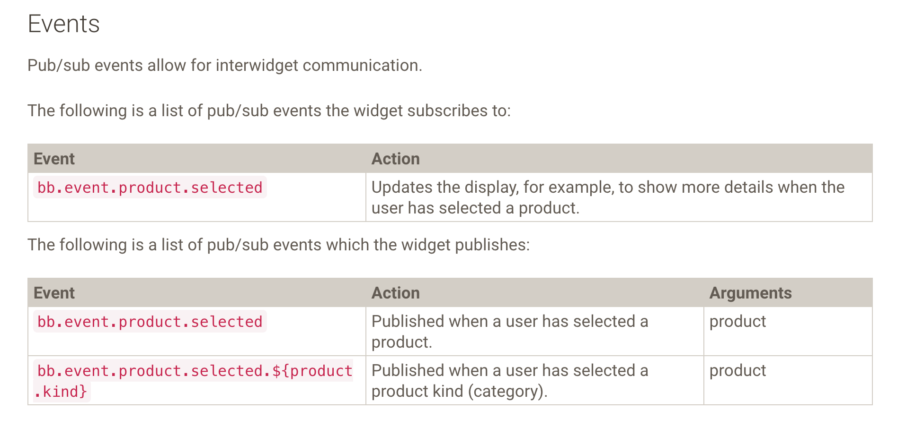
Events
Product Summary Widget events
Notes:
http://docs.backbase.com/extranet/technical-docs/collection-retail/2.3.0/widget-bb-product-summary-ng.html

Slide 25
Events
Product Summary Widget events
bb.event.product.selected
Purpose:
Published when a user has selected a product.
Arguments:
Selected product.
Example:
Subscribing to bb.event.product.selected
export const events = { “bb.event.product.selected”: (product) => console.dir(product) };
Notes:
Presentation template: It uses the Widget Controller.
Styles: Try to avoid the use of variables or mixins. You’re going to get duplicated code.
Behavior: You can refer to this url for further explanations: https://my.backbase.com/docs/product-documentation/documentation//Retail-Banking/2.3.0/extending-a-collection-widget.html

Slide 26
Events
Context object
Providing the context object is a common pattern for extension helpers and events when exporting them as functions.
Context object properties:
$filter: The angular $filter object
publish: The publish function. (Pub / Sub)
widget: The widget object.
export const events = ({ $filter, publish, widget }) => { “bb.event.product.selected”: (product) => console.log(product) };
Notes:
Presentation template: It uses the Widget Controller.
Styles: Try to avoid the use of variables or mixins. You’re going to get duplicated code.
Behavior: You can refer to this url for further explanations: https://my.backbase.com/docs/product-documentation/documentation//Retail-Banking/2.3.0/extending-a-collection-widget.html

Slide 27
Helpers
Extending Widget Functionality
Notes:
Before developing a widget, trainees need to understand what a widget is. For people that haven’t worked with BB portal before, there might be confusion with things like jquery widgets etc.

Slide 28
Helpers
“Sometimes you need some extra logic in your view that is not part of the controller interface. For this you can use helpers to move view logic out of the template.”
Notes:
Key points:
Mini-applications: they contain logic and perform operations, which is different from a ui widget like those defined in jquery ui, or in bootstrap
Autonomous: they should work, by themselves in any page that you use them, without depending on other widgets to function properly. This doesn’t mean that they need to contain all the libraries used. They can depend on js libraries that exist in the global project scope
Reusable: A widget is meant to be used multiple times, in different portals, in the same portal, and some times even in the same page. We need to keep this in mind while developing
Business Logic: Widgets should contain business logic and minimal styling.

Slide 29
Helpers
Implementing an extension helper
Example:
Highlighting products that have balance below zero.
export const helpers = ({$filter, publish, widget}) => ({ isLowBalance: (product) => product.availableBalance < widget.getLongPreference('lowBalanceThreshold') });
Tip: Widget API documentation
The helpers are made available on the root scope on ext.helpers.<helper-name>
<span ng-class="{low-balance: ext.helpers.isLowBalance(product)}"></span>
Notes:
Presentation template: It uses the Widget Controller.
Styles: Try to avoid the use of variables or mixins. You’re going to get duplicated code.
Behavior: You can refer to this url for further explanations: https://my.backbase.com/docs/product-documentation/documentation//Retail-Banking/2.3.0/extending-a-collection-widget.html

Slide 30
UI Components
Extending Widget Functionality
Notes:
Before developing a widget, trainees need to understand what a widget is. For people that haven’t worked with BB portal before, there might be confusion with things like jquery widgets etc.

Slide 31
UI Components
”UI Components maximize the reusability of frontend code, allowing the developer to build several views with the same frontend blocks”
Notes:
Key points:
Mini-applications: they contain logic and perform operations, which is different from a ui widget like those defined in jquery ui, or in bootstrap
Autonomous: they should work, by themselves in any page that you use them, without depending on other widgets to function properly. This doesn’t mean that they need to contain all the libraries used. They can depend on js libraries that exist in the global project scope
Reusable: A widget is meant to be used multiple times, in different portals, in the same portal, and some times even in the same page. We need to keep this in mind while developing
Business Logic: Widgets should contain business logic and minimal styling.

Slide 32
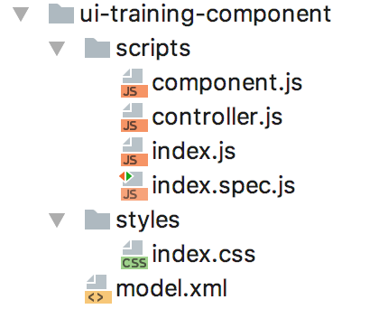
UI Components
UI Component scaffolding
Component (template)
Controller
Styling
Definition

